Slide 1

Databricks SQL Warehouse
John Miner Data Architect
john.miner@insight.com

Slide 2
Purpose
Many companies are moving their work loads from on-premise operational data stores to in-cloud data lakes. The spark processing platform is a key player in this transition.
Many end users do not know other languages and distributed processing concepts. How can we enable them to be productive in a spark environment?
Today, we are going to talk about the SQL Warehouse interface provided by Databricks.

Slide 3
Databricks SQL

Slide 4
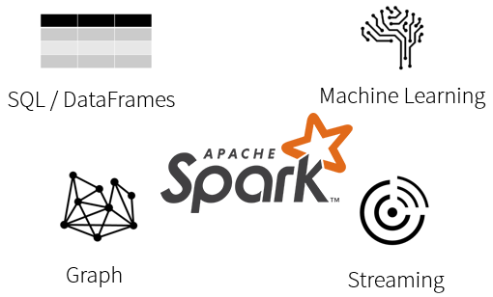
What is Spark?
Spark is a unified processing engine that can analyze big data using SQL, machine learning, graph processing or real-time stream analysis.
Familiarity with a programming language such as Python or Scala is a requirement.

Slide 5
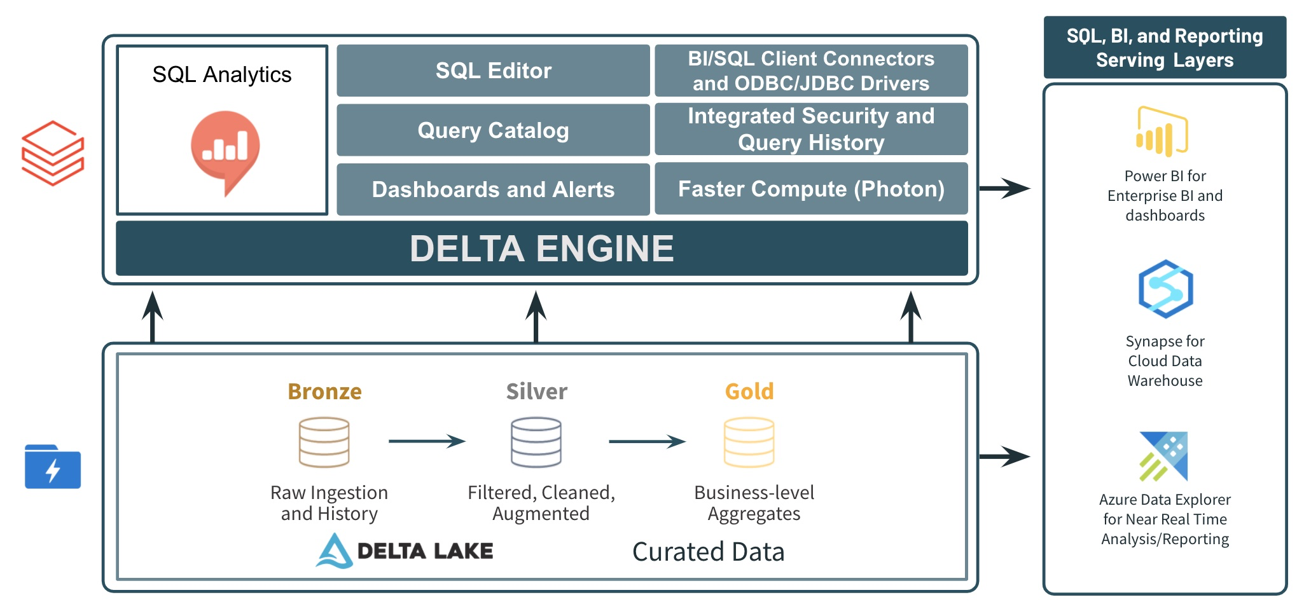
What is Databricks SQL Warehouse?
Databricks has designed an interface to make the spark eco-system look like a SQL Data Warehouse.

Slide 6
SQL Warehouse Interface
SQL Editor – explore hive catalog, create queries, execute one-time or on schedule and save code as files.
Workspace – manage folders, code files and dashboards.
Queries – review query executions.
Alerts – execute a query given a condition?
Data – explore the hive catalog.
Warehouse – define, start and terminate computing power.
Admin Console – set parameters for the warehouse.

Slide 7
Simple Database Example
To explore the warehouse interface, we are going to create a simple automobile database.
This example will explore the following SQL objects.
Schemas
Tables
Views
DML statements
Integrity
[example 1] – basic features

Slide 8
Data Lake Files

Slide 9
Azure Storage Redundancy
Most Azure Services are built upon the foundation that at least 3 copies of any data exists in a data center.
Business continuity can be increased by creating a duplicate set of data in another data center.
Data centers are automatically paired for this geo-redundancy. Thus, the North American East data center is paired with the West data center.

Slide 10
Access to Storage
There are several ways to access an Azure storage.
Storage Account Keys are an all-access pass to the resources. There are two keys per account so that rotation can occur.
Share Access Signature is a finer way to give out access. For instance, read access for the next 30 days can be give out this way.
Service Principle is a finer way to give out access for ADLS. Rights can be assigned at the folder and file level.

Slide 11
Copying Data 2 Azure Storage
There are many ways to perform this task. I am going to list two methods that can be automated with windows scheduler.
AzCopy is a utility from the Azure Resource Kit. Calling this utility from the command line with a shared access signature is one way to automate uploads. This engine is used by Azure Storage Explorer.
PowerShell is the defacto language to use with Azure. There are many cmdlets that deal with Azure Storage.

Slide 12
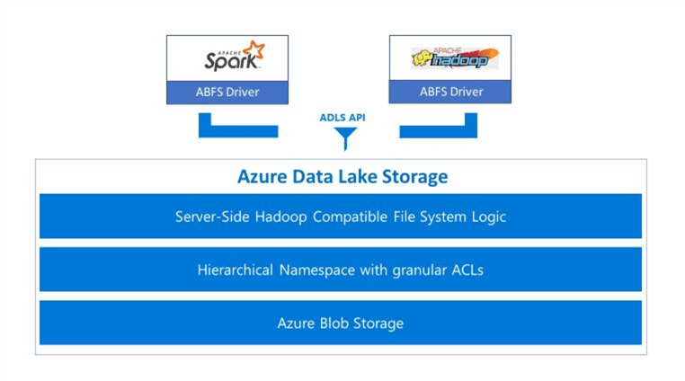
Azure Data Lake Storage - Details
The high-performance Azure blob file system (ABFS) is built for big data analytics and is compatible with the Hadoop Distributed File System.
New features in Gen2
encryption of data in transit & at rest
storage account firewalls
virtual network integration
role-based access security (RBAC)
hierarchical namespaces with granular ACL

Slide 13
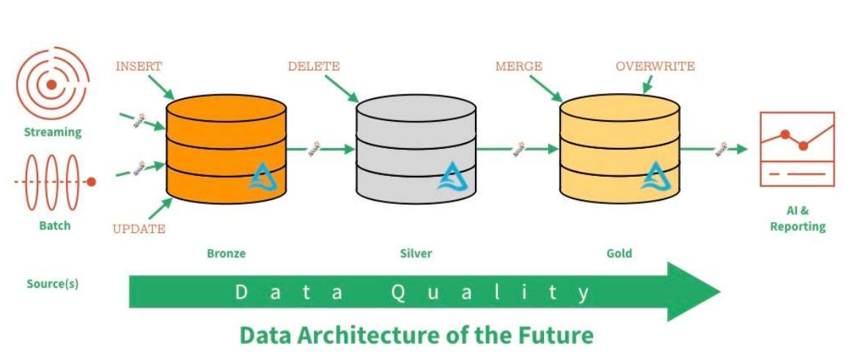
Data Lake – Zones & Data Quality

Slide 14
Various File Types
Weakly typed file formats can lead to data quality and ETL pipeline issues. For instance, a delimited file type as Comma Separated Values (CSV) can be easily broken. This file type does not allow for compression.
Strongly typed file formats can lead to better data quality and the least amount of ETL pipeline issues. For instance, an Apache Parquet file format is stored as binary data, contains columns names/types and allows for compression of the data.

Slide 15
Setup Data Access
There are three ways to access remote data from the warehouse. They are listed in order of preference. However, the complexity and security decreases as you go.
Service Principle
Storage Credential
Share Access Signature
[example 2] – azure storage explorer (files)

Slide 16
Loading Tables

Slide 17
Load Patterns
The full load design pattern involves replacing the target dataset with a completely new version. Use this pattern with small sized data.
An incremental load design pattern involves merging the target dataset with a small dataset the represents changes over a given time period. For instance, a daily update file. This pattern can be used with small to medium sized data.

Slide 18
Delta File Format – Uses parquet files +
ACID transactions make sure complete writes are committed.
Schema enforcement allows only clean data inserted into the lake.
Time travel allows for versioning the delta lake table. Thus, we can view data at any given point.
Snapshot isolation allows for multiple readers and writers.
Open-source format that is built for distributed systems such as Spark.

Slide 19
Hive Tables
Both managed and unmanaged tables can be grouped by a common named database (schema).
Managed tables allows the Spark engine to manage both the data and the metadata. Dropping a table results in the data being removed from the system if an INSERT action was used.
Unmanaged tables allows the Spark engine to keep track of the metadata for given file(s). Dropping a tables does not result in data loss.

Slide 20
Advanced Database Examples
Create the adventure works database from parquet files using COPY INTO syntax in silver zone.
Create the adventure works database from csv files as unmanaged EXTERNAL TABLES in bronze zone.
[example 3/4] – adventure works databases

Slide 21
Other Topics

Slide 22
Schedules, Dashboards + Alerts
Schedules
Queries can be set to run on a prescribed interval.
Dashboards
Queries can be created to support visualizations.
Parameters can be used to make visualizations dynamic.
Alerts
Queries can be created to support visualizations.
[example 5-8] – view + visualization + dashboard + schedule

Slide 23
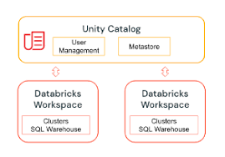
Unity Catalog
Companies might have multiple data lakes. How can you manage and share data between these workspaces. The unity catalog solves this problem.

Slide 24
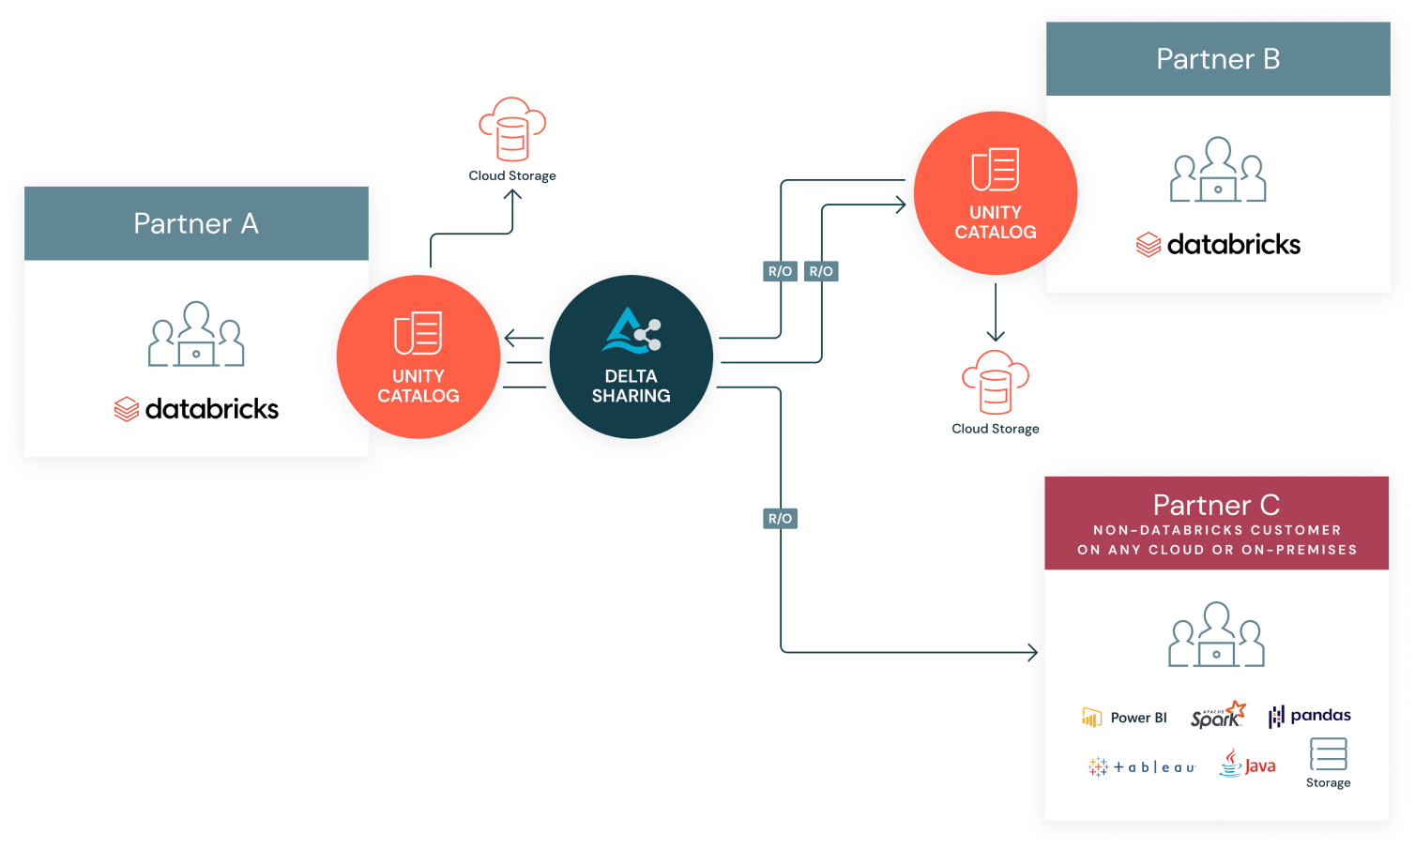
Delta Sharing
In the past, data was duplicated between department silos.
Today, delta sharing can be used to manage access to local and remote delta tables
(lake warehouses).

Slide 25
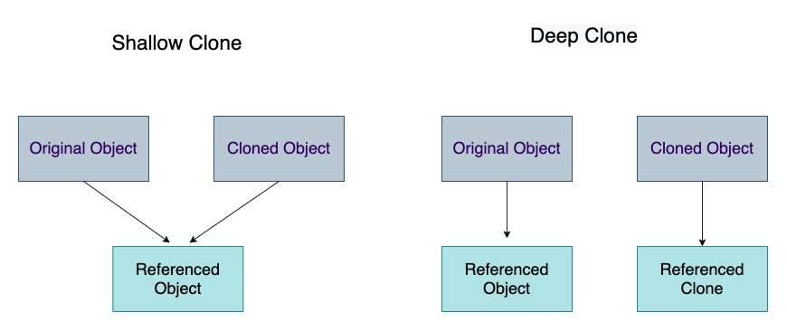
Table Cloning
How do you keep the development environment in synch with the production one? Shallow clones allow you to make zero copy duplicates.

Slide 26
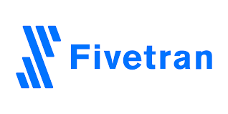




Third Party Products
Here are two products that you might want to use with your SQL Warehouse.
Move Data
Move Schemas
Corporate Reporting

Slide 27
In A Nutshell
Databricks SQL support is for basic SQL queries only. Procedure-oriented queries are not supported with current Databricks SQL version.
It is not supposed to replace advanced data engineering, graph or machine learning workloads running in Python/PySpark which we are currently handling.
Note: Databricks SQL provides a simple experience for SQL users who want to run quick ad-hoc queries on their data lake, create multiple visualization types to explore query results from different perspectives, and build and share dashboards.

Slide 28
Summary
The migration of data from on-premise to in-cloud will continue in the future. The Data Lake architecture using Delta Tables will be a common design pattern.
It is important to get adoption by existing employees to the newly created data lake. The SQL warehouse interface offered by Databricks allows technologist with a SQL background to get productive right away.
The unity catalog allows different groups and/or different data lakes to share data. While the visualizations and dashboards are immature, they will improve over time.
In short, consider the warehouse offering for groups of SQL users that need to work with a data lake.

Slide 29
References
Databricks Documentation
https://docs.databricks.com/index.html
Spark SQL functions
https://spark.apache.org/docs/latest/api/sql/index.html
SQL Language Reference
https://docs.databricks.com/sql/language-manual/index.html
Create Service Principle
https://learn.microsoft.com/en-us/azure/active-directory/develop/howto-create-service-principal-portal
Storage Explorer
https://learn.microsoft.com/en-us/azure/vs-azure-tools-storage-manage-with-storage-explorer
Secret Scope
https://learn.microsoft.com/en-us/azure/databricks/security/secrets/secret-scopes

Slide 30
Questions / Thank You

